Slide 1
Sedona Police Departments Citizen Police Academy
Class 16
Week 1

Slide 2
Introductions
Name
A little about yourself
Why you are in the class and what you hope to gain from the experience.
Please keep it to under 2 minutes.

Slide 3
Class Schedule
Snacks
Breaks
Questions

Slide 4
Group Exercise Peanut butter & jelly

Slide 6
Photo Line-Up
Scratch piece of paper
Read Admonition

Slide 7
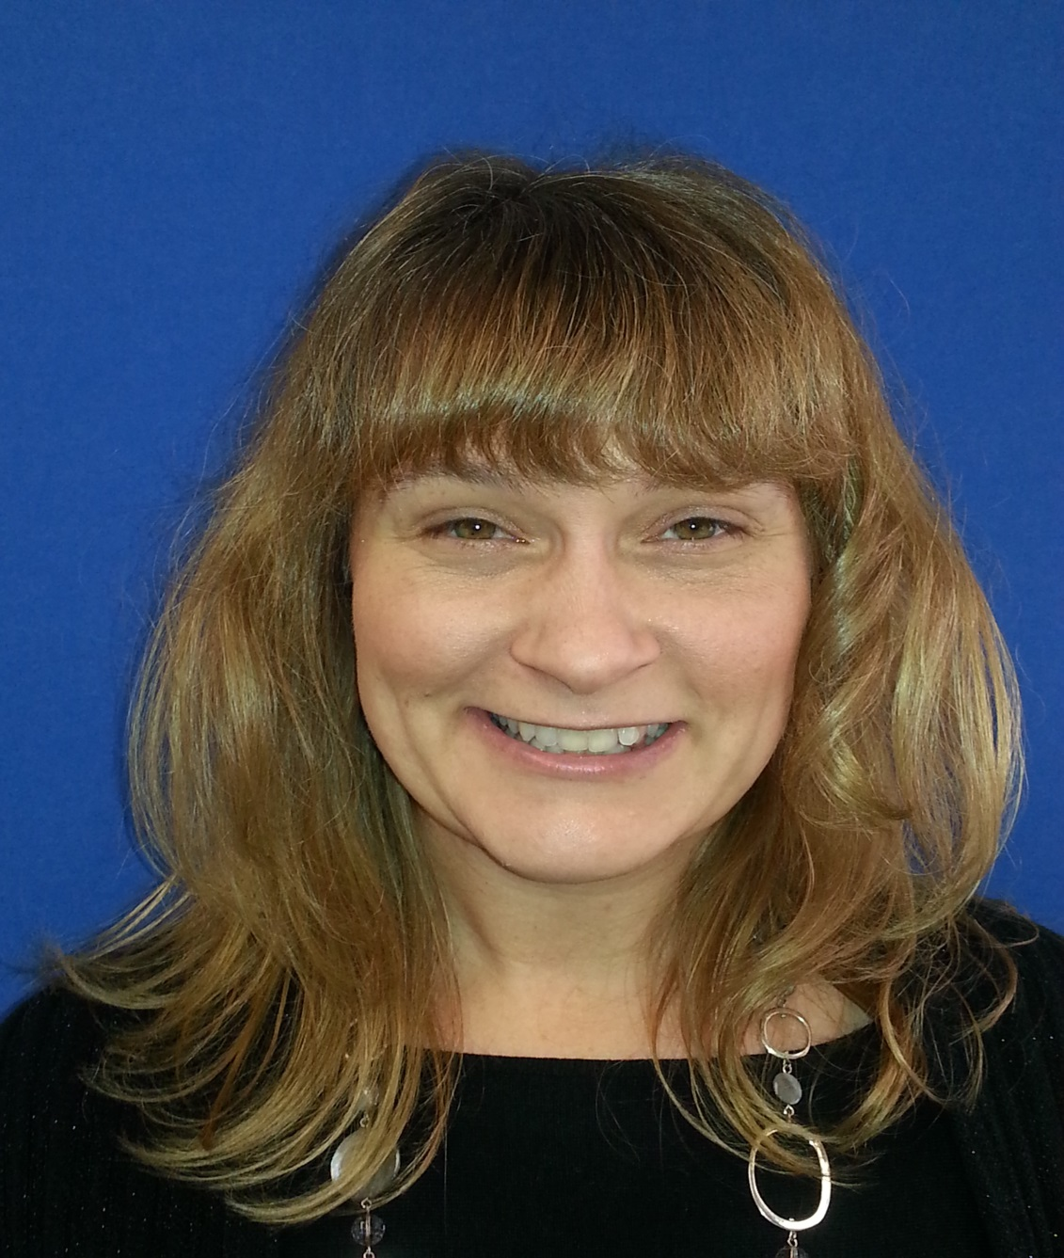
1

Slide 8
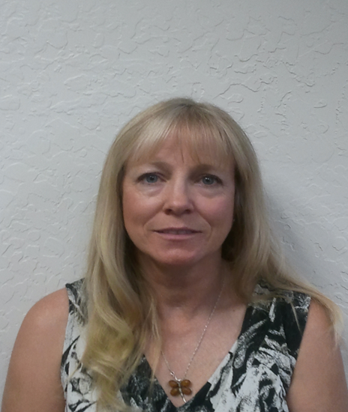
2

Slide 9
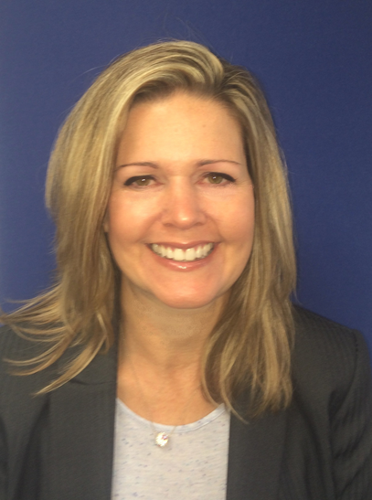
3

Slide 10
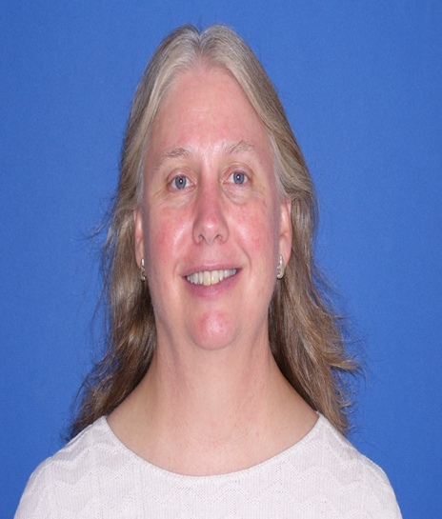
4

Slide 11
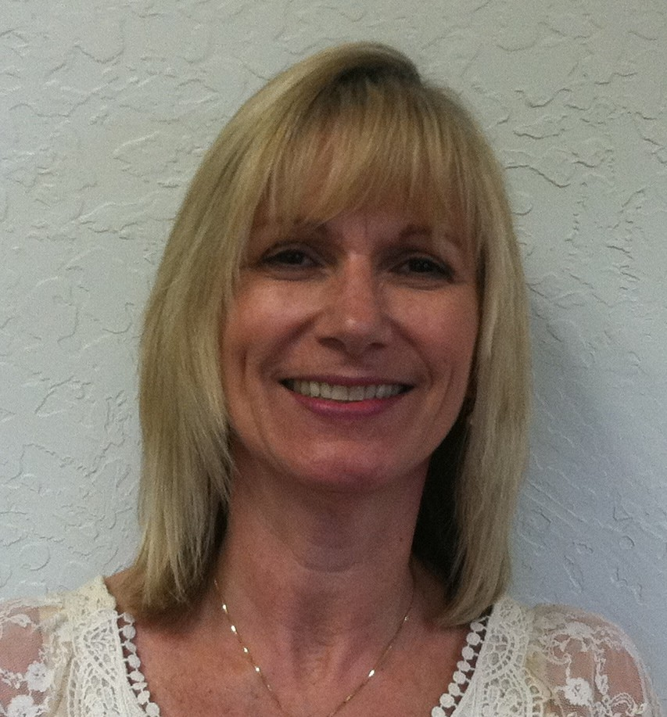
5

Slide 12
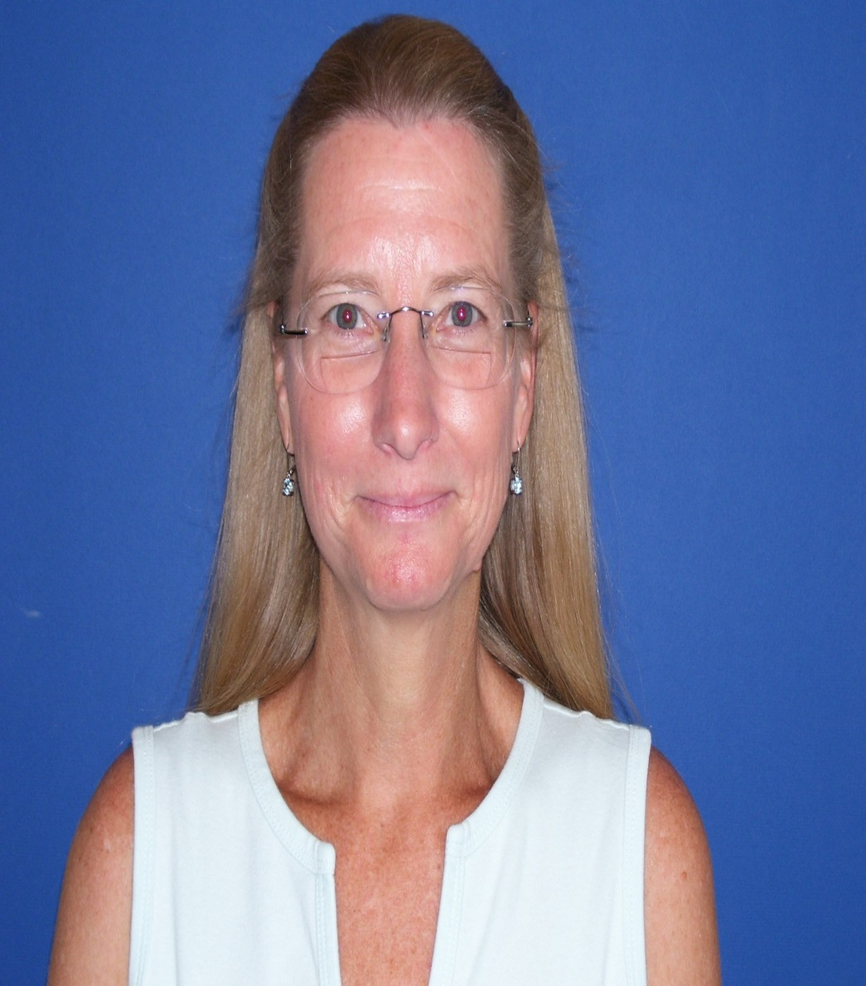
6

Slide 13
Photo #3

