Slide 1
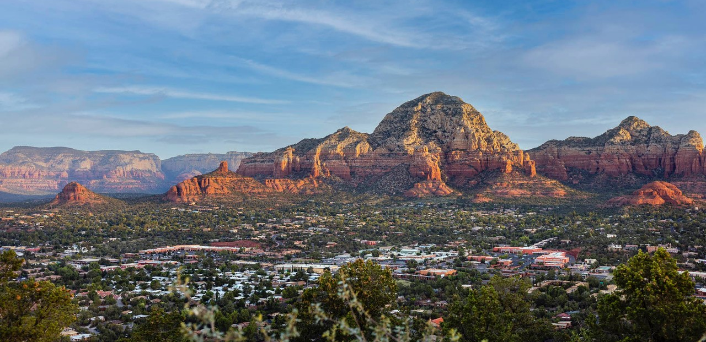
Sedona
Winter 23/24 Campaign

Slide 2
Campaign Goals and Objectives
For the winter campaign, we aimed to deliver a positive Return On Ad Spend (ROAS) and show direct attribution for the marketing dollars and how they resulted in driving hotel stays and broader economic impacts.
We specifically targeted winter visitation from key historic flight markets:
NYC
Chicago
Minneapolis
And worked to build awareness in new/emerging markets:
Seattle
San Diego
Las Vegas
San Francisco
Denver
Santa Fe
Durango
Park City

Slide 3
Key Takeaways
Programmatic (via Datafy) campaigns are bringing the majority of traffic to the new Scenic Sedona website. During the campaign we saw more than 19,000 new users to the site.
Our top markets for visitation to the destination aligns with the top delivery markets. We are seeing direct correlation to those that were served Sedona’s winter ads showing up in the destination.
All campaign benchmarks were met or exceeded.
With an Average Daily Rate of $301 (per Smith Travel Research) during this campaign, and an average visitor spend of $190/trip (per Visitor Intercept Survey), there is an estimated $409,171 of total economic impact from this campaign to date. This is an 8.7:1 Return on Ad Spend thus far.

Slide 4
Sample Campaign Creative Assets
(Top Performer)

Slide 5
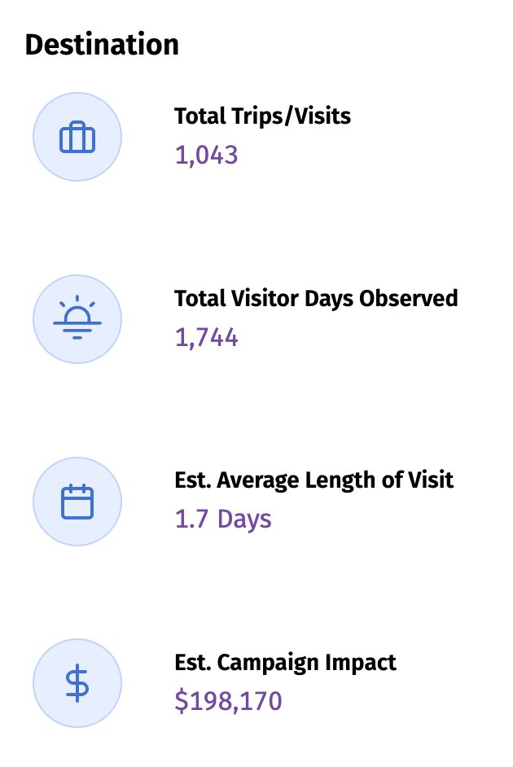
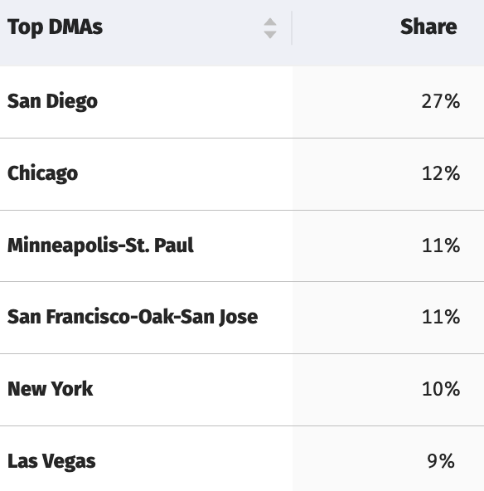
Attribution Results - Destination
Top DMA’s for visitation to the destination aligns with the top delivery markets. We are seeing direct correlation to those that were served our ads showing up in the destination.
This data is through Feb 10, 2024. It will continue to be updated, typically with a three-week lag in reporting.
Notes:
Attribution results reflect those users that were served an ad and were subsequently observed in the destination. These visits and visitor days are 1:1, there are no extrapolations.

Slide 6
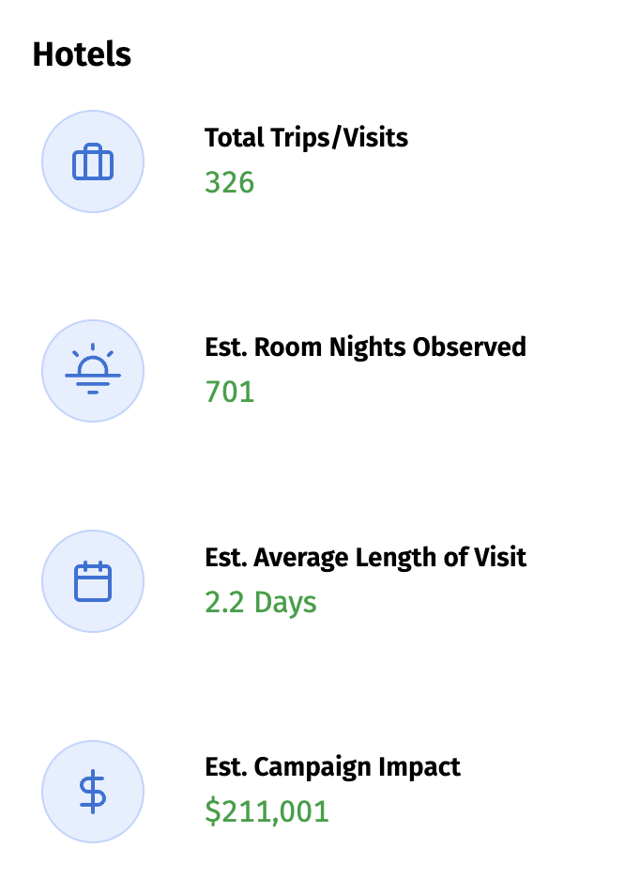
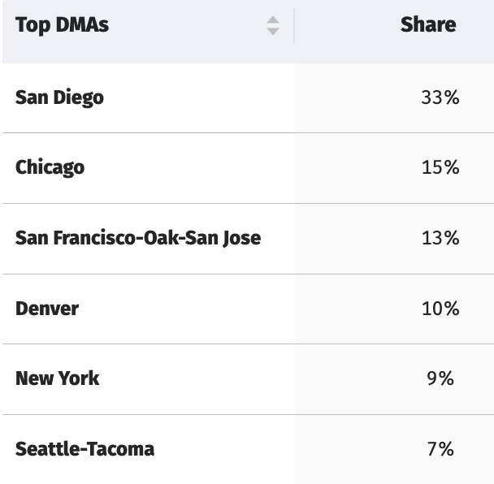
Attribution Results - Hotels
Overnight stays in hotels also align with top delivery markets and audience targeting.
More than 67% of all visitors that came from our advertising stayed in a hotel.
Notes:
Attribution results reflect those users that were served an ad and were subsequently observed in a hotel within the city limits of Sedona. These visits and estimated room nights are 1:1, there are no extrapolations.

Slide 7
THANK
YOU

