Slide 1
CITY OF SEDONA TOURISM PROGRAM TAB Update
Notes:
Cheryl, Brent, Lonnie

Slide 2
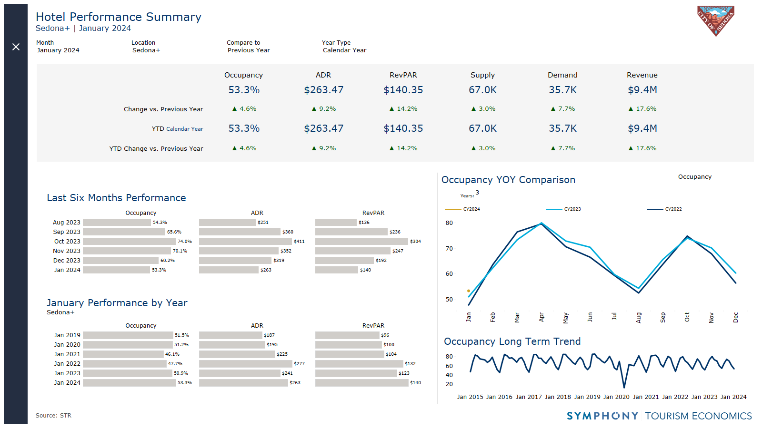
Notes:
I like this chart on the right that explains where we are in 2023 in occupancy compared to the other years.
Hotel performance comparing Nov 22 to Nov 23 is good
Whereas we’ll see where December lands since you can see that year to date compared to last year, our ADR and RevPar is down.
Revenue per available room (RevPAR) is an assessment on if a hotel can fill its rooms at the rate that it has them listed at. RevPAR is calculated by multiplying a hotel's average daily room rate by its occupancy rate.

Slide 3
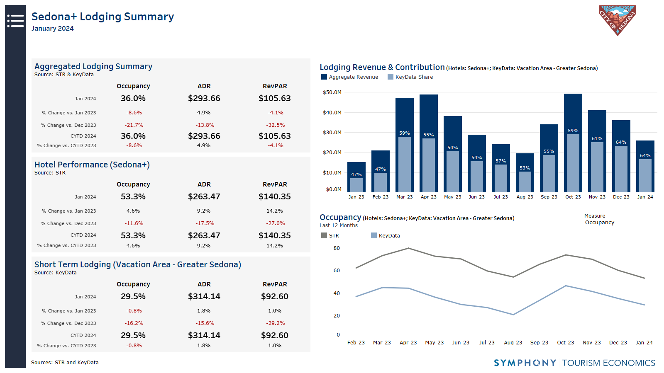

Slide 4
Notes:
Compared to last month: New York, Palm Springs and Salt Lake were in the bottom three there. Whereas Denver and Albuqeuarqu snuck in there this time and New York and Salt Lake dropped off.
We also went from a 2.5 days av length stay to 2.8 days from Dec. to Jan.

Slide 5
Notes:
Top five are still the same as Dec.
We went from 2 days as av length of stay to 2.2 days

Slide 6
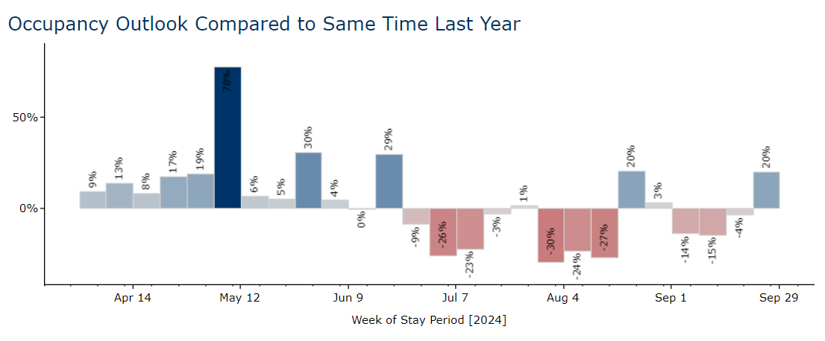
Future hotel demand looks strong in spring, softer in summer
Notes:
Pace is ahead every week through the first week of May with the exception of 4/14, that was Easter week last year.

Slide 7
Notes:
Extrapolation
Take that spend amount as a trend only. It accounts for in market spend, is an extrapolation and doesn’t include Am Ex users.

