Slide 1
Go West Summit
February 26-29, Lake Tahoe

Slide 2
What is it?
Started in 1990 by International Tourism Marketing
Focuses on western states
US and international receptive operators

Slide 3
How did we do?
40 appointments, average is 36
12 minutes each
Focused messages:
12 months in the year, disperse visitation
Arts & culture focus
Trailhead shuttle use
Longer stays, less day trips

Slide 4
Who are the RTOs?
RTO: receptive tour operator, tour company specializing in tourism experiences. One stop shop for international and/or domestic operators.
Destination America, America 4 You, Excursionist, Hotelbeds, Tour America and more.

Slide 5
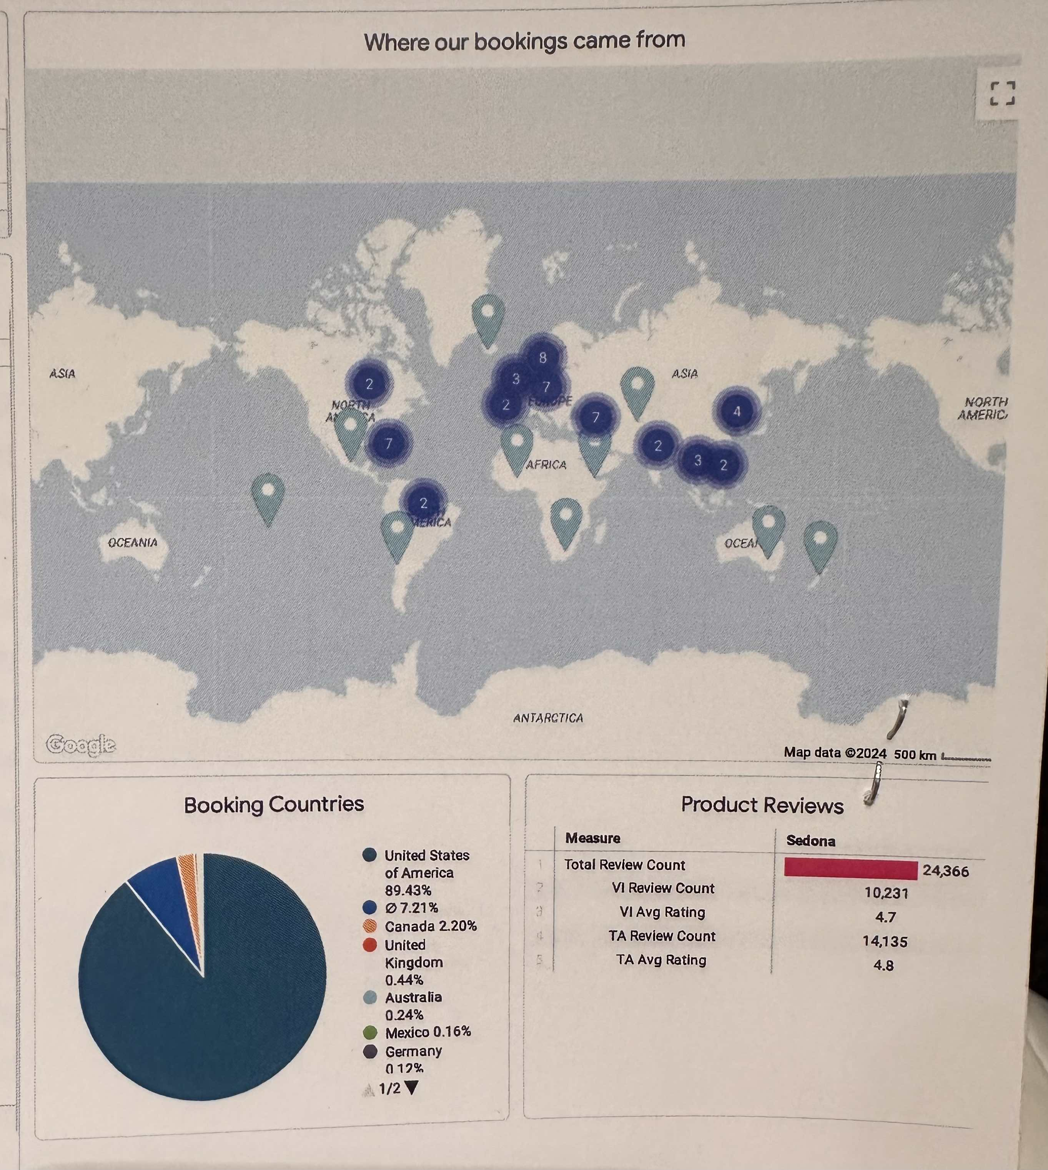
Viator: Online Travel Provider
Sedona data: 7% increase 2023 over 2022
Attraction categories by rank:
Arizona Safari
Verde Canyon RR
Great Venture Tours
Sedona Vineyard Tours
Red Rock Jeep
Sedona Star Gazing

Slide 6
What do they want?
Introductions for new lodging options or nudge those they are reaching out to
Dining options for groups
Attractions: different, unique, and customized
Hiking trails: not the usual hikes

Slide 7
Go West Summit January 6-9, 2025 Palm Springs, CA

