Slide 1
City of Sedona
Brand Platform
DRAFT
February 28, 2024

Slide 2
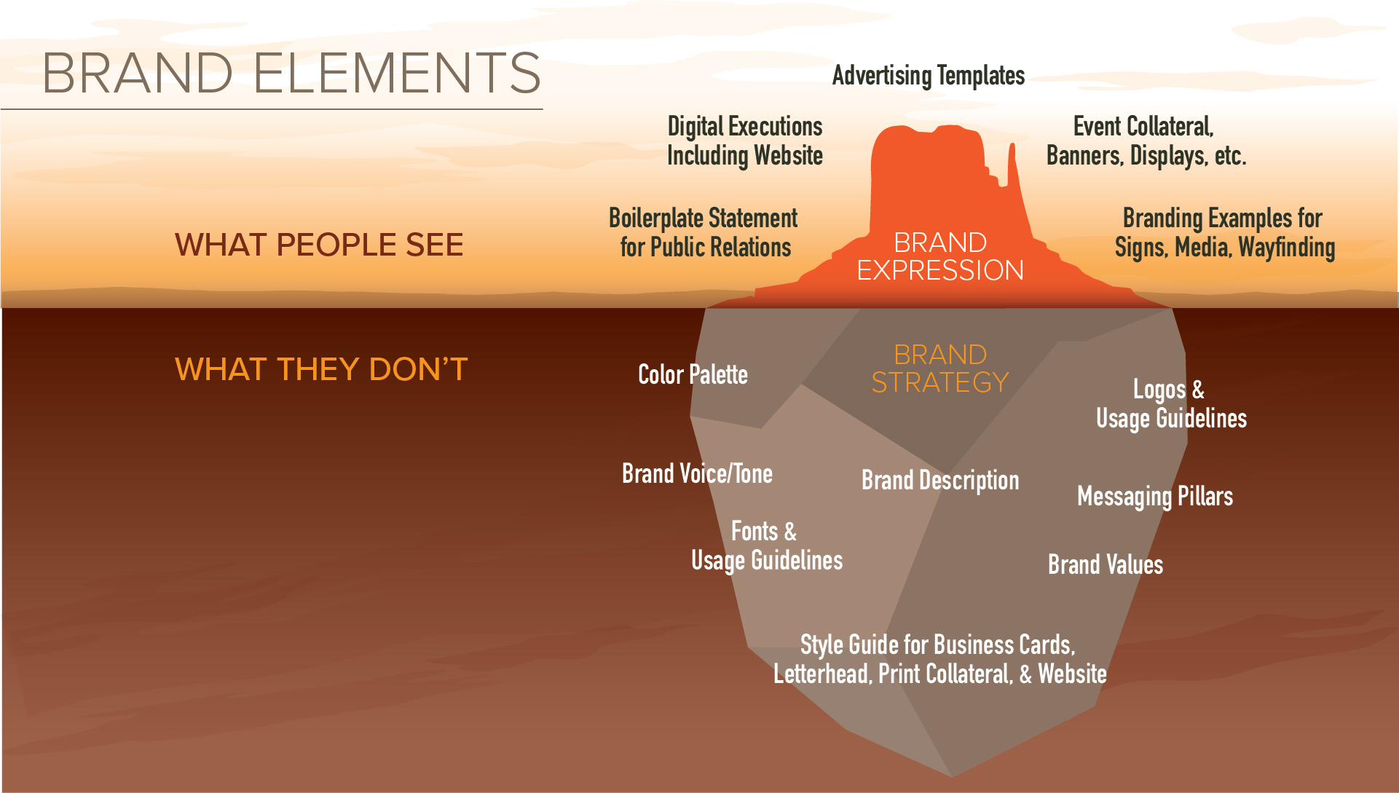

Slide 3
RESEARCH-DRIVEN
Resident Sentiment Survey
Community Listening Session
Councilmember Interviews
Lodging Council Listening Session
TAB Listening Session
Visitor Intercept Survey
Chamber Interview
Visitor and Spend Analysis
Awareness and Perception Survey

Slide 4
KEY INSIGHTS
Focus on how unique and special this place truly is – the surroundings, the art, the culture, the energy, the dining, and the shops – worthy of love, protection, and sharing with visitors and future generations.
Emphasize the idea of Sedona’s need for respect and protection since it can never be replaced – a concept that applies to residents, stakeholders, and visitors.
Sustainability underscores everything – from protecting the fragile environment to ensuring economic benefit is spread as evenly as possible year-round, long term, and across the commercial sector.
Resident quality of life underlies everything.

Slide 5
BRAND GOAL
Create harmony between the destination, residents, visitors, businesses, and the brand.
THE DESTINATION
RESIDENTS
VISITORS
BUSINESSES
THE BRAND

Slide 6
BRAND VALUES
SUSTAINABLE
COMMUNITY-MINDED
SINCERE
Stewardship-focused. Committed to the long-term viability of the community, and a tourism industry that is additive to the destination as opposed to extractive.
Protecting and enhancing year-round vitality. Fostering greater livability for residents, while also finding ways to enhance the visitor experience.
A genuine respect for and appreciation of all who live here or visit. Staying true to our principles. Highly accountable, with a strong moral and ethical compass.

Slide 7
BRAND VOICE
Sedona's brand voice is rooted in the three brand values: Sustainable, Community-Minded, and Sincere. The Voice aims to resonate with the hearts and minds of our audience. It's a Voice that speaks with warmth, wisdom, and sincerity, echoing the timeless allure and depth of experience found nowhere but Sedona. It's a voice that encourages preservation, and celebrates community, embodying the resilience and sustainability of the land and the community, be they visitors or residents.
Inspirational & Uplifting
Educational & Respectful
Friendly & Inviting
Authentic & Sincere

Slide 8
BRAND CHARACTERISTICS
SEDONA IS
Fragile
Vibrant
Enchanting
Breathtaking
Spiritual
A National Treasure
Authentic
Sustainable
Resilient
Mosaic
SEDONA IS NOT
Indestructible
Dull
Mundane
Boring
Unmoving
A National Park
Fabricated
Disposable
Complacent
One-dimensional

Slide 9
BRAND DESCRIPTION – INTRO
The Sedona brand platform is the foundation from which all future stewardship and marketing efforts will be built upon and measured against.
The brand description is one of the least visible elements of the broader brand platform, as opposed to the many public-facing elements it spawns. It is developed deliberately and with very specific intention reflecting the research, interviews, perspectives and intents of residents, businesses, and visitors.
As such, the Sedona brand description should be both realistic and aspirational. Through words, it reflects not only who we are today, but also who we want to be in the future. And as Sedona changes and evolves, so too will the brand description. Think of it as a living, breathing document that guides us and the work we do in education and marketing.

Slide 10
BRAND DESCRIPTION – UPDATED
There’s no place else quite like it. Instantly recognizable. Profoundly captivating. The immensity of Sedona’s natural beauty evokes feelings of wonder and connection. So much so, that anywhere else, the surrounding landscape would likely be a National Park.
For generations, and for countless years before that, the towering red rocks, juniper, pine, and cypress trees have stood the test of time. From exhilarating to tranquil, Sedona’s combination of natural wonders, spiritual energy, and artistic allure combine to foster a stronger sense of community, a greater sense of place, and a more intimate connection to the land.
In town, a lodging, dining, arts, and culture scene rivals that of cities many times its size, yet somehow Sedona manages to retain its endearing character and enduring charm. But that’s exactly the beauty of Sedona. Here, residents and visitors embrace their place within a vibrant tapestry of community and nature.
There’s also no place quite as precious. Silent, fragile, and vulnerable. There’s only one Sedona, and how we care for, treat, and respect it today will determine its viability – and livability – for future generations. This land, this town, and the very fabric of Sedona have been entrusted to us. Residents and visitors alike, we are all stewards of this sanctuary.
Nowhere do so many pieces fit so perfectly together as they do right here. A special place to love, respect, cherish, and protect alongside those who share our ethos.
There never has been – and there never will be – another place quite like it. Sedona.

