Slide 1
SEDONA
2024 Summer Sustainability Campaign Media Plan

Slide 2
CAMPAIGN GOALS
2024 Summer Bridge Campaign

Slide 3
Campaign Goals
Convey a stewardship message within Sedona, in Phoenix and key summer visitation markets
Drive a positive return on ad spend (ROAS) above 5x for the Datafy portion of the buy
Drive demand and bookings for Sedona lodging properties
Generate attributable economic impact for the City of Sedona

Slide 4
MARKET ANALYSIS
2024 Summer Bridge Campaign

Slide 5
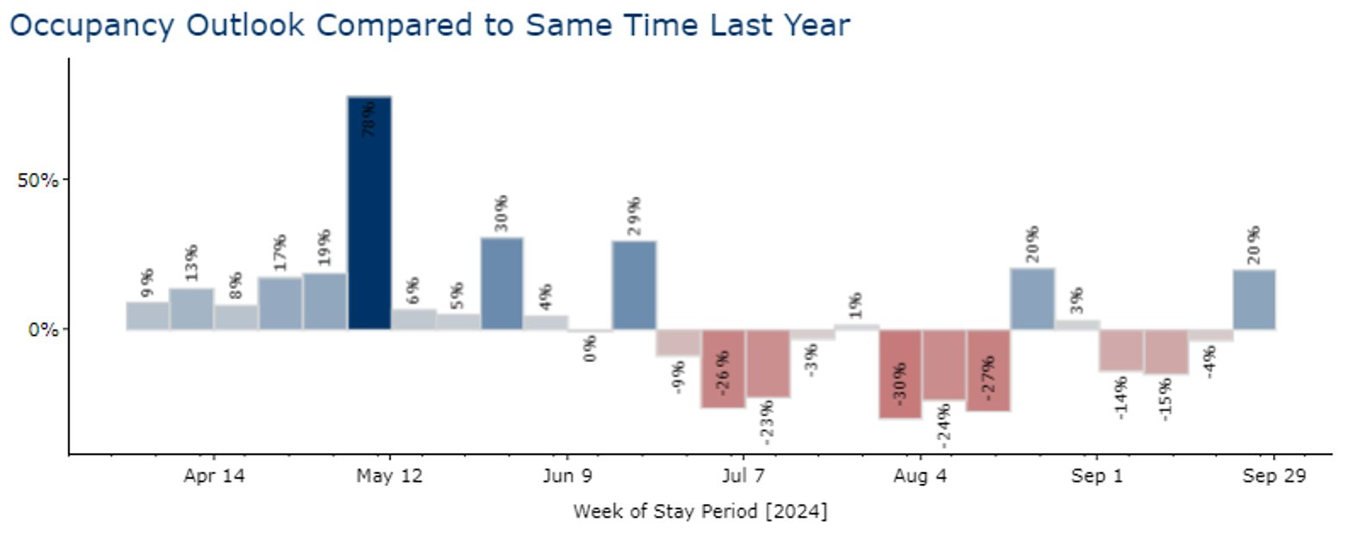

Slide 6
Top Visitation Markets - Lodging/Summer
Top Markets by 4-Year Ave. % Visitation
Phoenix 40%
Los Angeles 8.24%
Tucson 4.20%
New York 3.75%
Chicago 2.33%
Dallas 2.08%
Las Vegas 2.01%
San Diego 1.70%
Houston 1.47%
Atlanta 1.35%
Visitation metrics were filtered by those that stayed in Sedona lodging properties only.

Slide 7
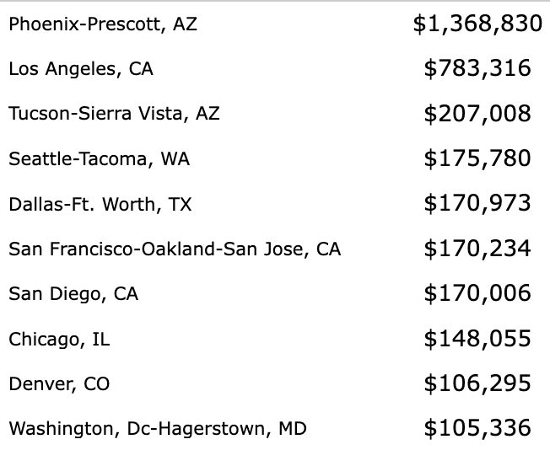
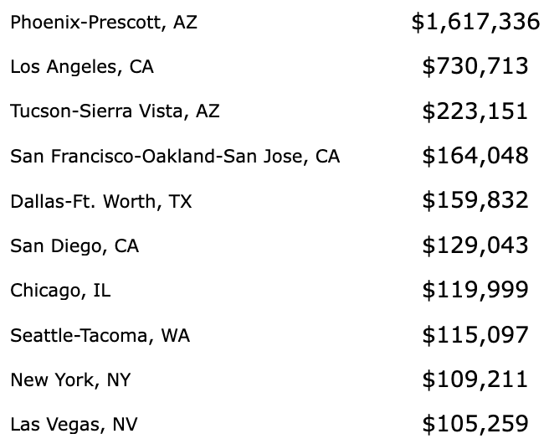
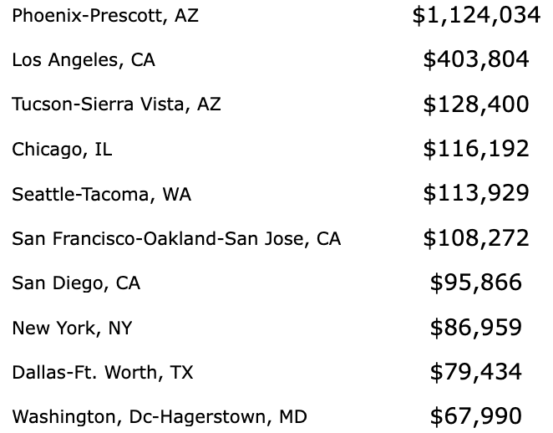
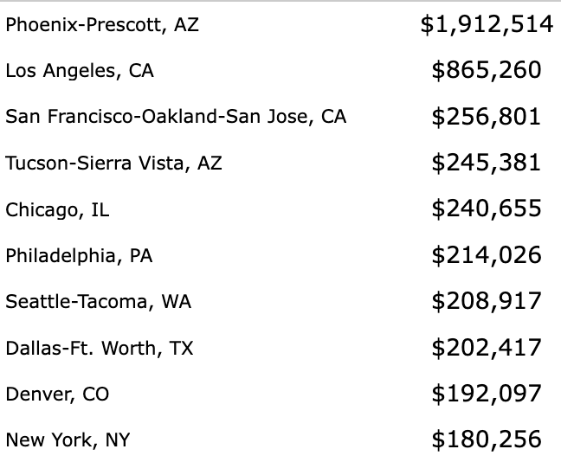
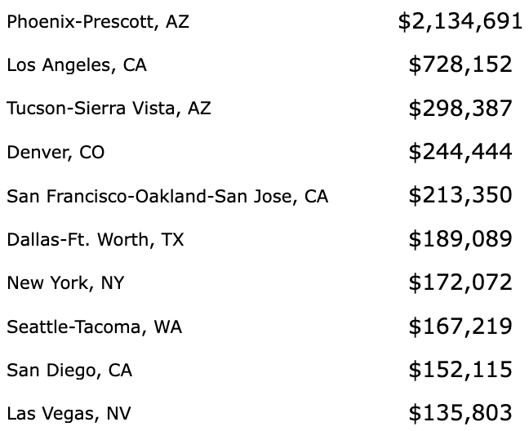
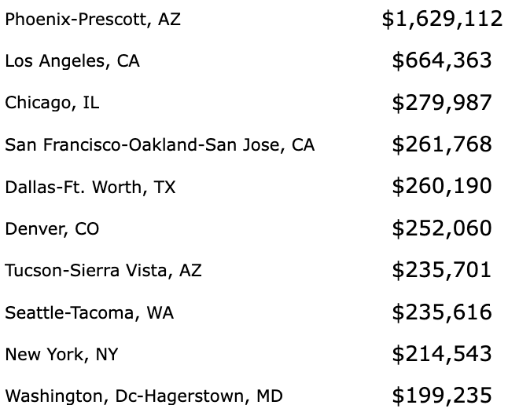
Top Spend Markets
JUNE 2023
JULY 2023
AUG 2023
JUNE 2022
JULY 2022
AUG 2022

Slide 8
Top Summer Spend Markets
Top Market by Ave. Spend
Phoenix 41.8%
Los Angeles 17.81%
Tucson 5.76%
San Francisco 5.02%
Dallas 4.54%
Seattle 4.35%
Chicago 4.3%
Denver 4.25%
New York 3.30%
San Diego 3.19%
We review spend data from Symphony for the period of June through August for both 2022 and 2023.
The numbers in the table represent the percentage of the total spend during this time period.

Slide 9
Top Summer Markets Summary
Top Markets by 4 Year Ave. % Visitation
Phoenix 40%
Los Angeles 8.24%
Tucson 4.20%
New York 3.75%
Chicago 2.33%
Dallas 2.08%
Las Vegas 2.01%
San Diego 1.70%
Houston 1.47%
Atlanta 1.35%
Top Market by Ave. Spend
Phoenix $1.63M
Los Angeles $694,000
Tucson $224,000
San Francisco $195,000
Dallas $176,000
Seattle $169,000
Chicago $167,000
Denver $165,000
New York $128,000
San Diego $124,000
Green highlighted markets showed up in both data sets. These would be the recommended target markets for the summer campaign. Recent awareness and perception research also showed that residents of Phoenix are 20% more likely to visit Sedona during the months of May-August, making them not only an appropriate target for summer visitation, but the prime audience for stewardship messaging.
With an increased budget for summer, DVA would also recommend continuing the marketing efforts in Seattle, Las Vegas, Denver, and San Francisco.

Slide 10
MEDIA RECOMMENDATION
2024 Summer Bridge Campaign

Slide 11
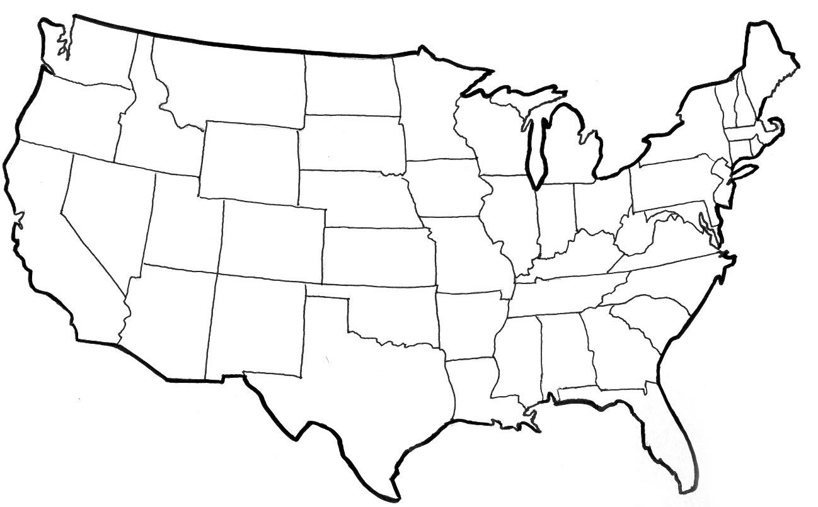
Audience Mix & Target Markets
A mix of social media, paid search and Datafy’s programmatic ad service. We will target:
Past-visitors, new visitors with a propensity for outdoor adventure/travel, unique shopping, and dining experiences.
Include Household Incomes (HHI) above $100K and households with 1-2 and 3-5 members.
Additionally, since the campaign will be equally developed for educational purposes, we will target in-market visitors, with sustainability messaging, as well.
Core Markets
Emerging Markets

Slide 12
Campaign Details
Media spend: $100,000+ but final amount TBD
Flight: May 1 to August 15, 2024
Tactics: Paid social media; native, display, video, and retargeting; paid search
Target Markets (reference slide 8)
In-Market
Depending on the Chamber’s BID summer marketing campaign this campaign could pivot to:
Exclude the overlapping markets
Focus on only in-market marketing

Slide 13
THANK YOU
2024 Summer Bridge Campaign

